Slide 1
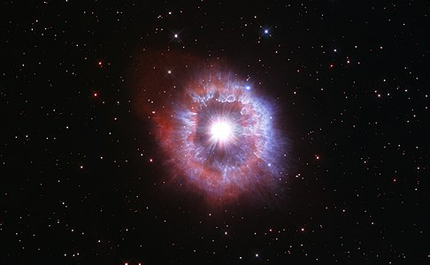


What Drives the Variability in Luminous Blue Variable Stars?
Mari Beltran, Becca Spejcher
Mentor: Dr. Noel Richardson
Department of Physics & Astronomy
Embry-Riddle Aeronautical University
Background image: Hubble image of AG Carinae, a known LBV

Slide 2
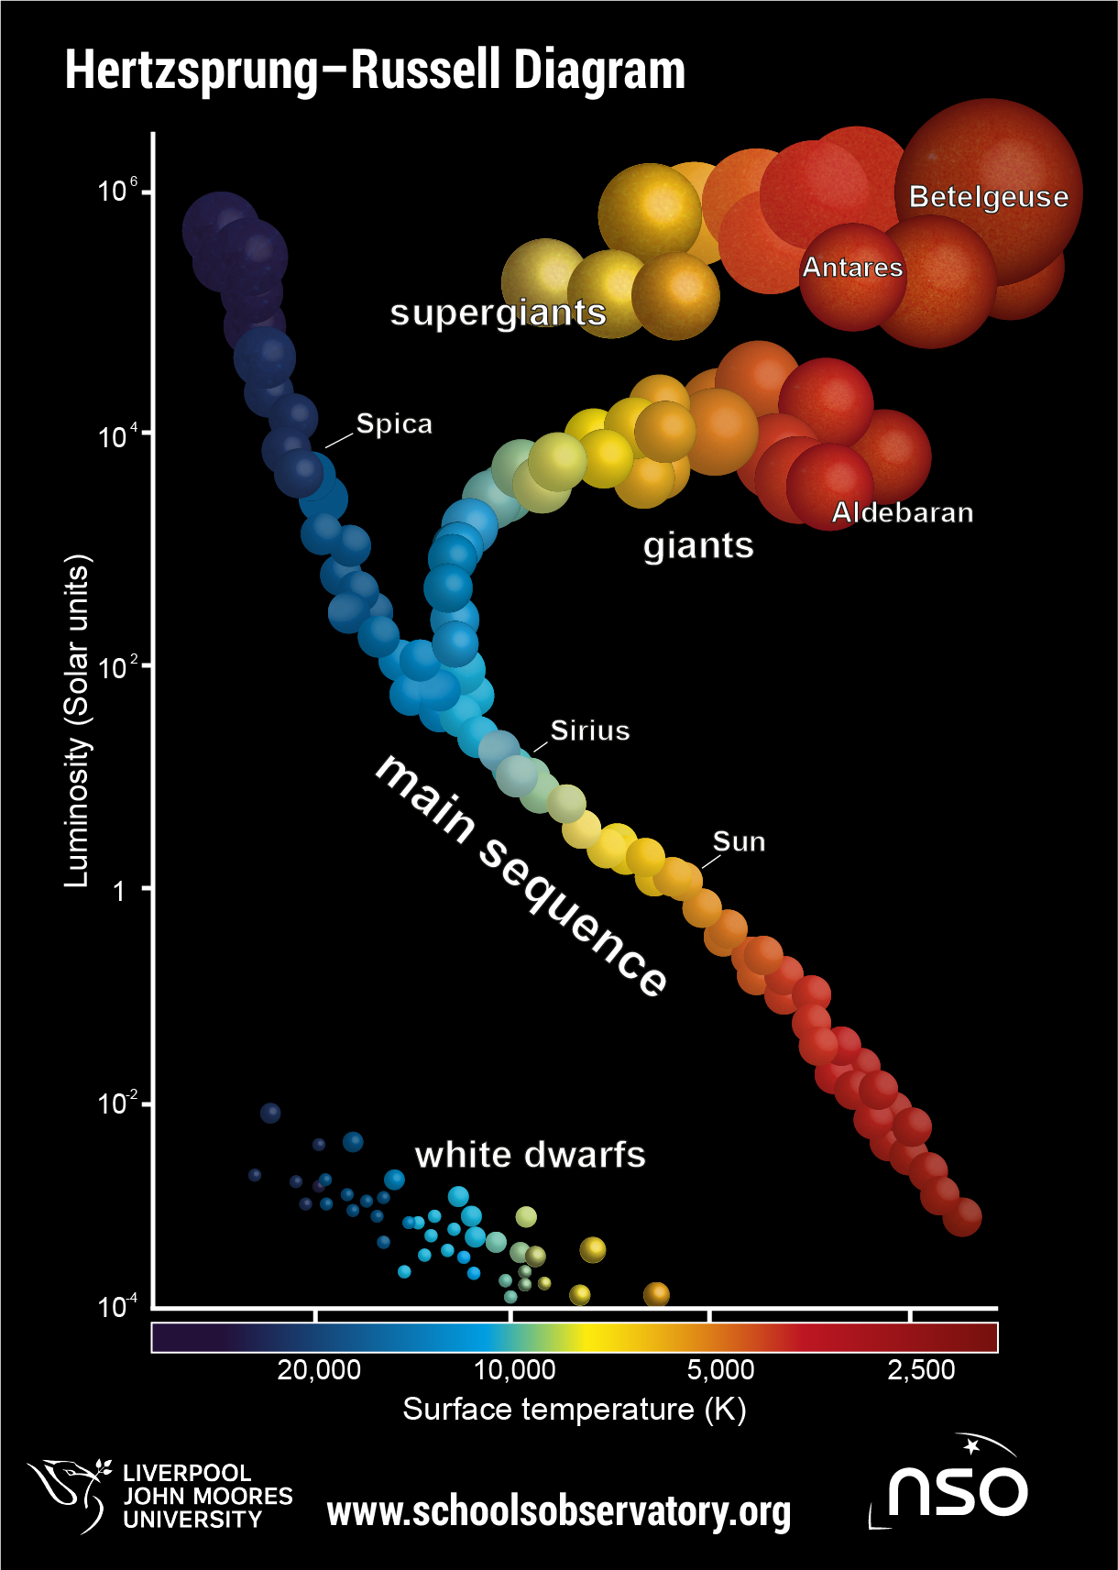
What are Luminous Blue Variables?
They are here
High luminosity
Large radii
Very high mass-loss rates
Variability on time-scales of days to centuries
Including large eruptions that expel upwards of several solar masses of material
The graph to the left is a Hertzsprung-Russel (HR) diagram marking the location of LBVs

Slide 3
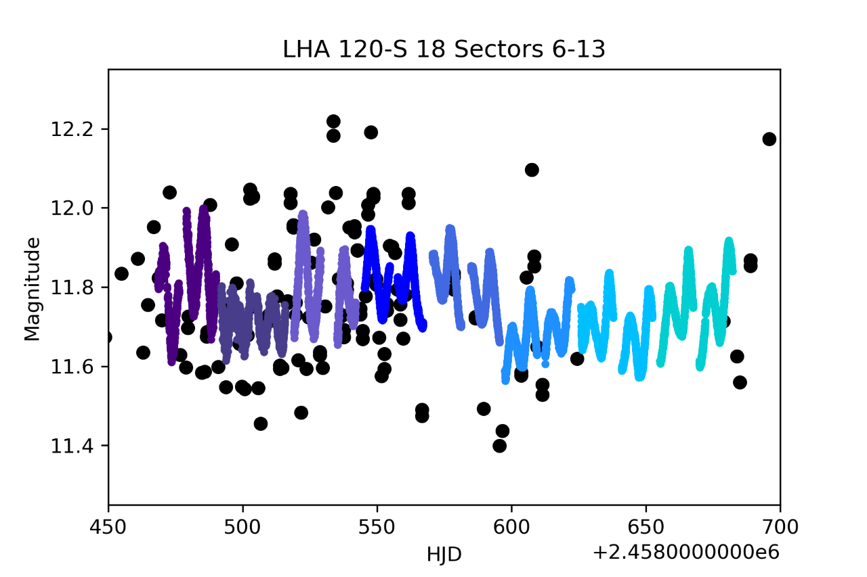
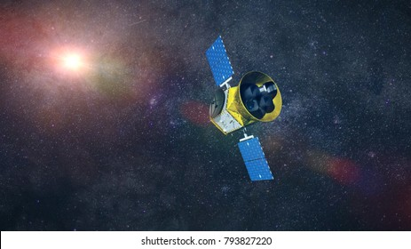
Goals
Compute light curves
Perform & analyze Fourier transformations
Use findings to determine internal driving mechanisms
Sequence of TESS vs. ASAS-SN data, sectors 6-13
Image of TESS

Slide 4
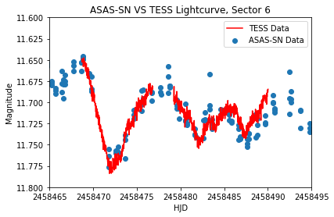
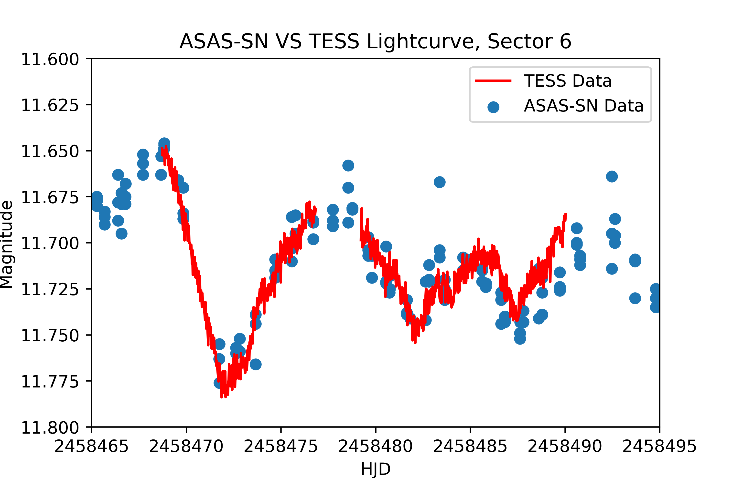
Methods
Photometric data from TESS
Perform a Fourier analysis of these light curves
This is the light curve of HD 269687. The light curve shows TESS sector 6 data compared to ground-based ASAS-SN data, to ensure the data are properly handled.
Notes:
These are light curves showing brightness variations with time
Data from Large and Small Magellanic Clouds
See the figure on the top right for one small portion of one star's light curve
This is the light curve of HD 269687. The light curve shows TESS sector 6 data compared to ground-based ASAS-SN data, to ensure the data are properly handled.

Slide 5
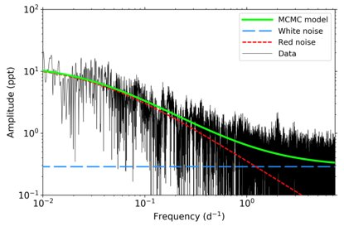
Expected Results: Fourier Analysis
Graph of a Fourier Analysis of P Cygni (Elliott et al. 2022)
Notes:
Elliott et al. analyzed the nearby LBV P Cygni (results shown in the Fourier transform to the right).
Similar results were used
Characteristic timescale was found to have a variability of ~ 1 month, with an amplitude of ~ 1%
Indicates the driving mechanism could be either from internal gravity waves or a result of subsurface convection
We expect with a large sample of LBVs, we will be able to characterize their variations and examine the driving mechanisms, placing these stars in the context of all massive stars.
The FT informs us what the overall power distribution is as a function of timescale. For systems with a singular frequency like eclipsing binaries, one peak and Ethan’s harmonics are what we find. For LBVs, the variations aren’t necessarily periodic, so we get a characteristic timescale and amplitude of the variations- we compare that to models to determine what the driving mechanisms can be.
White noise tells us the normal noise in the FT. Red noise tells us the characteristic amplitude and frequency of the distribution
White and red noise fit to a Fourier transform of P Cygni

Slide 6
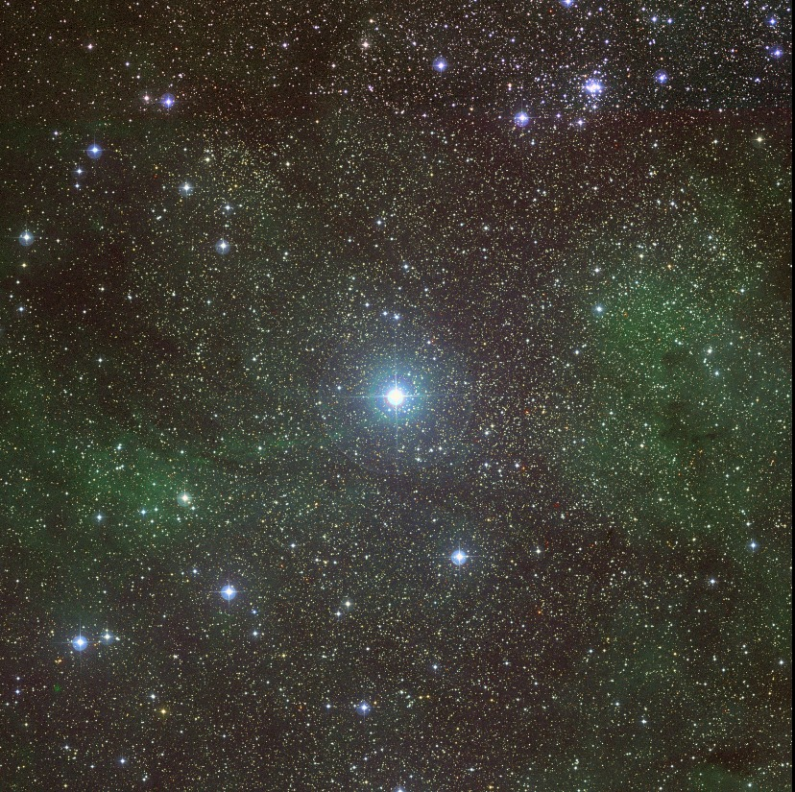
Impact
Characterize variations and driving mechanisms
Places LBVs in context of all massive stars
Deeper understanding of stellar evolution
Image of P Cygni, the known LBV that has known driving mechanisms of variability

Slide 7
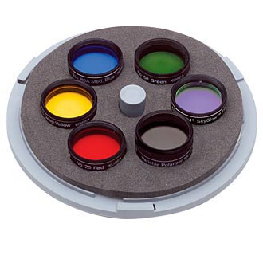
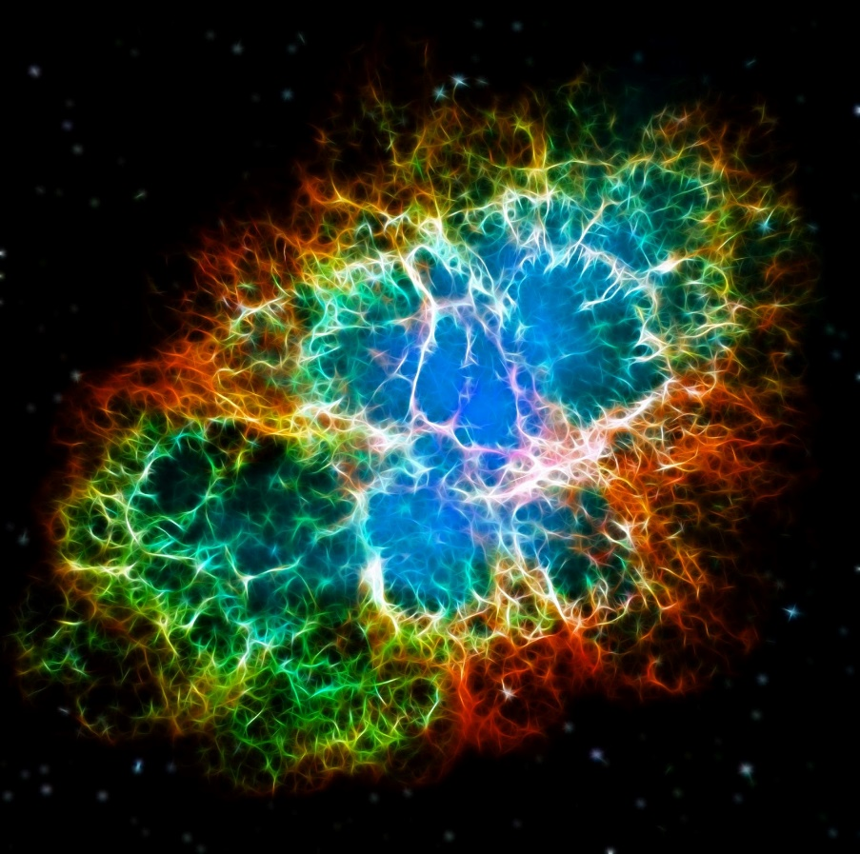
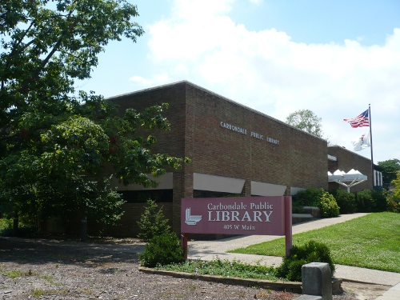
Outreach
NASA@MyLibrary
Astronomical filters
“Ask an astronomer”
Demos

Slide 8
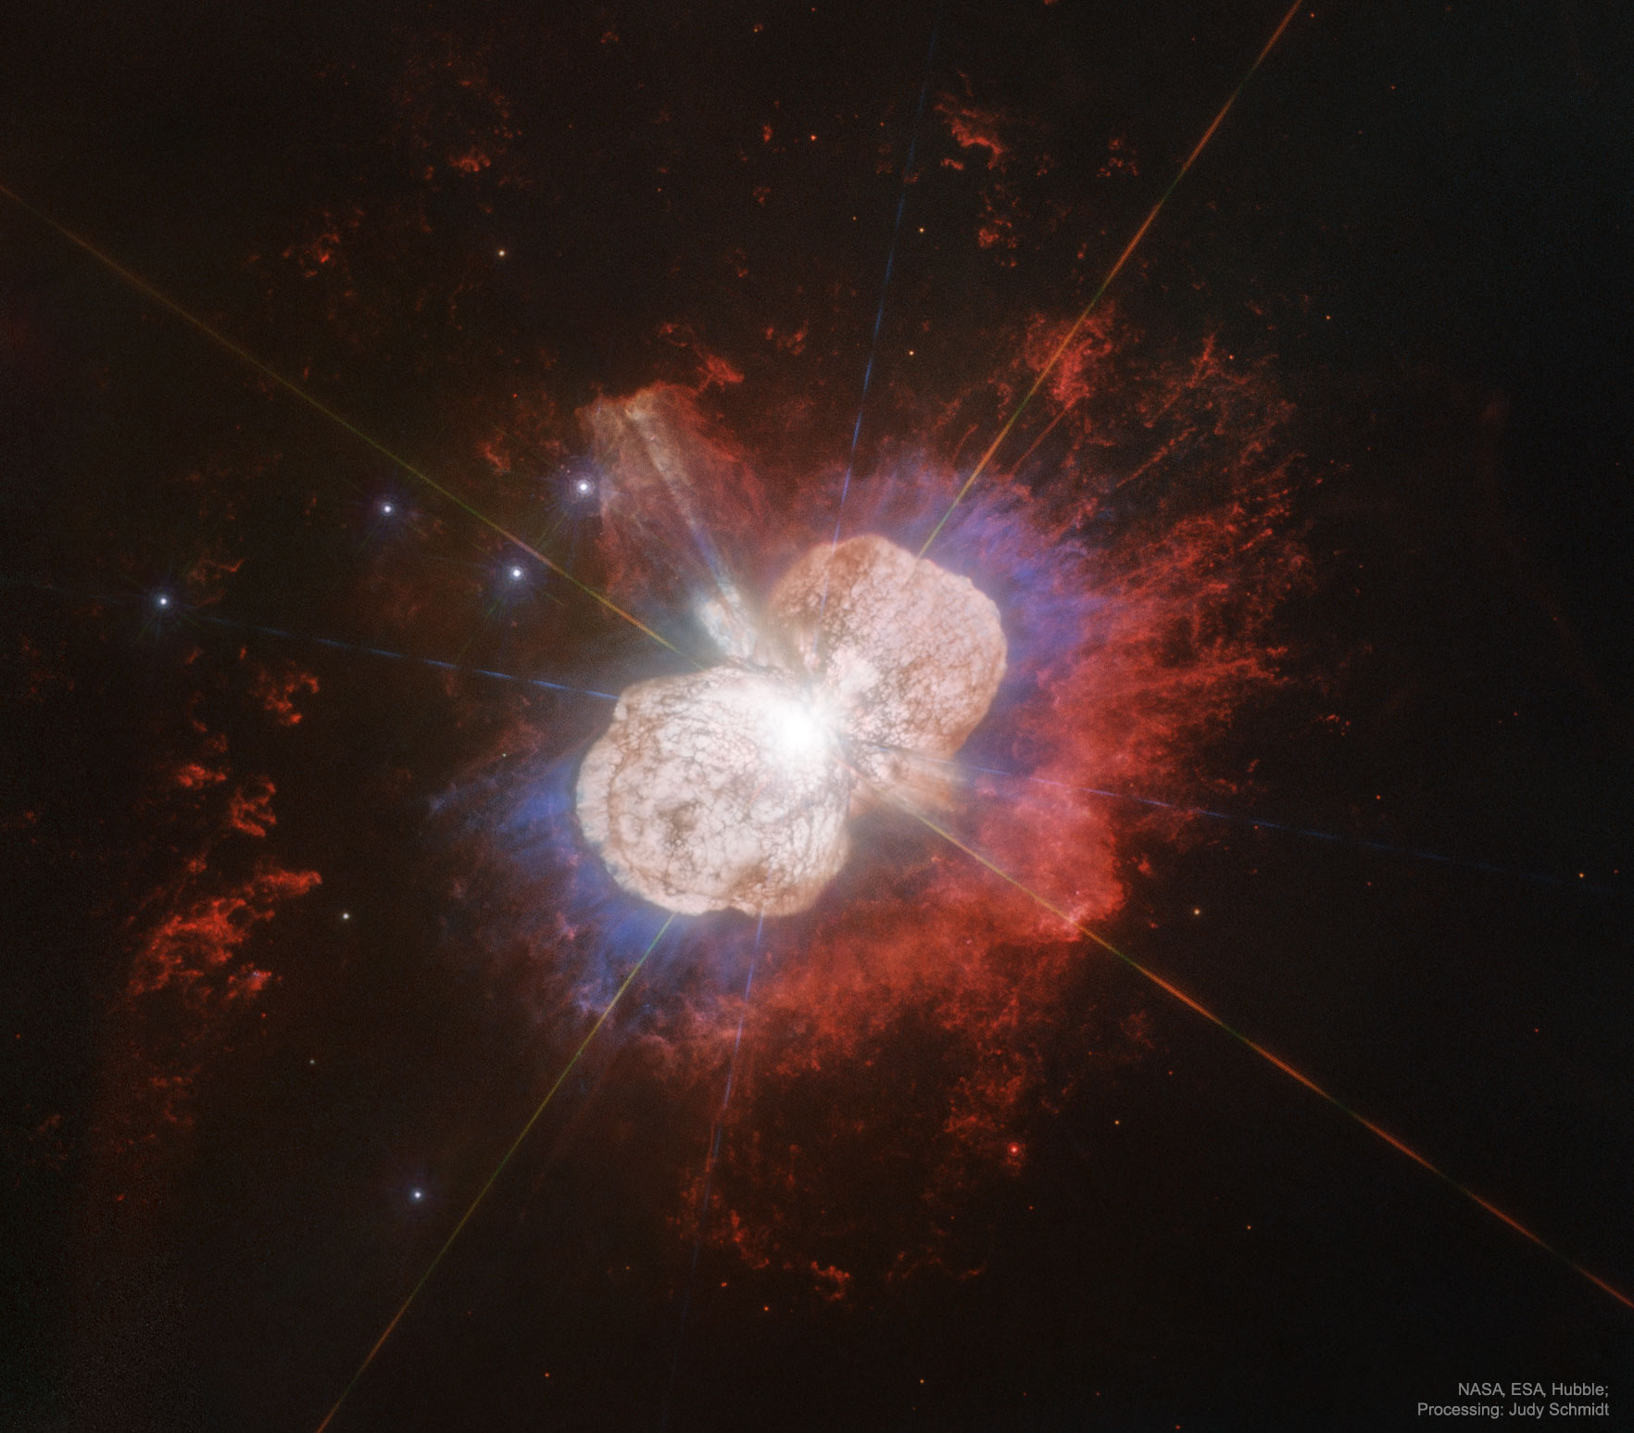
Summary
Use light curves to compute Fourier transforms
Analyze Fourier transforms for internal driving mechanisms
Fit LBVs into stellar evolution
Astronomy Picture of the Day: Eta Carinae

